Slide 1

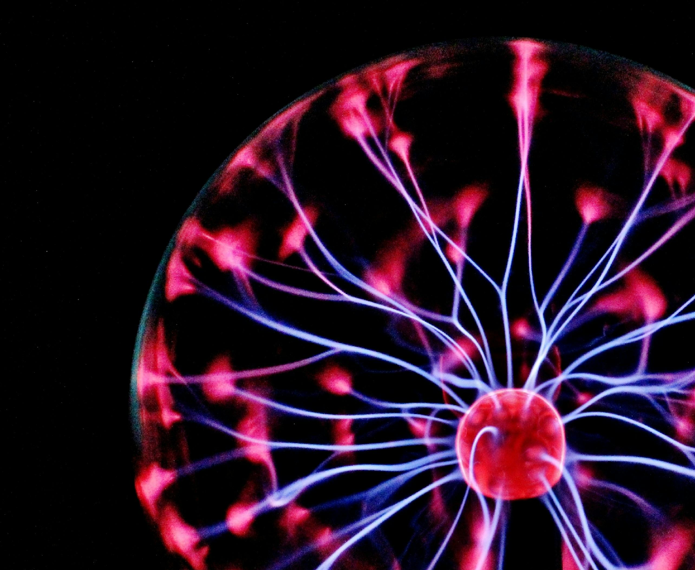
Decoding the rules of RNA colocalization
Mohit Joshi
BTech Biotechnology
Semester 7
Institute of Advanced Research

Slide 2
“The central dogma tells us which genes are expressed, but not where in the cell those gene products operate - or how RNAs are spatially organized to carry out coordinated functions and their location.”

Slide 3
Hypothesis: mRNA’s sequence contains “zip code” or set of rules or common sub sequences between each mRNAs that dictates it’s location and neighbouring RNAs.
Method: Deep learning model to predict mRNA’s local transcriptomic neighbourhood directly from it’s neighbour RNA sequence to discover “Rule of Association”
Raw Data: Image-based spatial transcriptomics datasets with single-molecule resolution (x, y, z coordinates) to x y z coordinates
CosMx (nanostring)
Xenium (10x genomics)
Vizgen
U-2 OS MERFISH dataset (Zhuang Lab)

Slide 4

Preprocessing Label Generation
Input Data prep for Transformer model: CSV HDF5 file
K Nearest Neighbour (KNN) for neighbourhood search for each RNA molecule to find it’s neighbouring RNA molecule (basically a lookup for nearer RNA molecules)
This Neighbourhood gene would then be converted to Probability Vector (X) $\left(\frac{nearest gene nos. probability}{total nos. of genes detected}\right)$
Get the “Reference full mRNA/Transcriptome sequence” (GeneCode or RefSeq) and convert it into probability Vector (Y)
Molecule_ID | Gene | X (μm) | Y (μm) | Z (μm) | Cell_ID
0001 | GAPDH | 11.2 | 23.0 | 3.0 | Cell_5
0002 | ACTB | 10.5 | 22.3 | 3.2 | Cell_5
0003 | HNRNPA1 | 50.1 | 60.4 | 6.7 | Cell_13
... | ... | ... | ... | ... | ...

Slide 5
Modelling Sequence(X) and Reference (Y)
We need a model which can:
Read long RNA sequences
Understand Non-Local dependencies (far apart structures and motifs)
Learn Mappings to high Dimension output space
This is where Transformer architecture comes in to play
Some referenced Transformer architectures (from literature review):
RNABERT (Functional RNA clustering and structure alignment from RNA-base embeddings)
Nucleotide Transformer (An AI Foundation model for Genomics)

Slide 6
DNABERT / RNA-BERT
Nucleotide Transformer
Transformer architecture for Modelling Sequence(X) and Reference (Y)
Transformer take Vector embeddings as input by tokenizing (3-mer or 6-mer sequencing)
Stack 4-12 Transformer encoder self attention layer
Positional encoding matches the vectors X to vectors Y
Output vectors are received in the form of X connected to Y (ref)
For Model validation loss function is checked
KL Divergence (compares X probs to Y Probs how far or near they are)
Cross entropy (generic multi class model loss)
Use activation function (sigmoid) to convert into gene probability distribution

Slide 7
DNABERT / RNA-BERT
Nucleotide Transformer
Biological validation (need to be figured out based on experiment, but based on literature review)
Biological Discovery (method)
- Attention Maps for motif discovery: Extract attention scores from Transformer layers and visualise the heatmap and look for multiple high attention RNA sequence.
- Group them from Attention Maps
- We can then form Biological Hypothesis by learning patterns like:
- Using Gene Ontology enrichment analysis on predicted neighbourhoods, we can predict their functional relativeness to each other.
- All transcripts predicted to be in this RNA's neighborhood are part of the glycolysis pathway.
- This subsequence ‘AUUGGAUUGGU’ is found in 80% of transcripts localized to Processing bodies.
- This colocalization rule is only learned in neurons, not fibroblasts.

Slide 8
Thank you

Slide 9


